Slide 1


A Resource-Sharing & Pipelined Design Scheme for Dynamic Deployment of CNNs on FPGAs
Hanchen Ye, Gengsheng Chen
State Key Laboratory of ASIC and System, Fudan University
11/03/2018

Slide 2
Outline
Resource-Sharing Pipeline
Hardware Design Architecture
VGG-16 Experiments and Analysis
Conclusion

Slide 3
Outline
Resource-Sharing Pipeline
Hardware Design Architecture
VGG-16 Experiments and Analysis
Conclusion

Slide 4
Resource-Sharing Pipeline (1)
FPGA Dynamic Partial Reconfiguration (DPR) Technology
FPGA Chip
Partial Reconfigurable Block (PRB)
PRB Bitstreams
Static Logic

Slide 5
Resource-Sharing Pipeline (1)
FPGA Dynamic Partial Reconfiguration (DPR) Technology
FPGA Chip
Partial Reconfigurable Block (PRB)
Logic A
Logic B
Logic C
Static Logic
dynamically reconfigure the PRBs Logic
while the other part of FPGA continue running

Slide 6
Resource-Sharing Pipeline (2)
Mechanism of RS-Pipeline (4-stages RS-Pipeline as example)
target algorithm
8 pipeline stages
Data 0
FPGA Chip
Data 1
1
2
3
4
Data 2
Configuring Stage 0
Configuring Stage 4
Stage 0
Stage 4
Data 2
Data 3
Data 4
Data 5
Data 1
Data 0
Data 3
Data 4
Configuring Stage 5
-
Stage 5
Stage 1
Configuring Stage 1
Data 5
Configuring Stage 2
-
Stage 2
Configuring Stage 6
Stage 6
-
Configuring Stage 7
Configuring Stage 3
Stage 3
Stage 7
Features of 4-stage RS-Pipeline:
Always 3 data on FPGA.
Always 3 PRBs in computing status.
Always 1 PRB in reconfiguring status.

Slide 7
Resource-Sharing Pipeline (3)
Mechanism of RS-Pipeline (4-stages RS-Pipeline as example)
RS-Pipeline
two stages share one PRB at different time
Resource-Sharing

Slide 8
Resource-Sharing Pipeline (4)
Comparison between RS-Pipeline and normal pipeline
RS-Pipeline
 | Normal | RS-Pipeline
Resources | R | 2R
Latency | L | 0.5L
Performance | P | 0.75P
↑100%
↓ 50%
↓ 25%
RS-Pipeline allows for larger algorithm
RS-Pipeline provides lower latency
Normal Pipeline

Slide 9
Resource-Sharing Pipeline (4)
Comparison between RS-Pipeline and normal pipeline
RS-Pipeline
latency too long
No Pipeline
Normal Pipeline

Slide 10
Outline
Resource-Sharing Pipeline
Hardware Design Architecture
VGG-16 Experiments and Analysis
Conclusion

Slide 11
Hardware Design Architecture (1)
Top-Level Architecture
Efficient data and control flow
MCU: Use MicroBlaze to control the process of RS-Pipeline
PRC: Use Partial Reconfiguration Controller to reconfigure PRBs
Novel “Butterfly” memory structure
Even and odd PRBs load/save data from different DDR
Average memory occupation on each DDR to improve memory access efficiency

Slide 12
Hardware Design Architecture (2)
Convolutional Layer Architecture (HLS)
Step 1
Step 2
Step 3
Three steps work concurrently

Slide 13
Outline
Resource-Sharing Pipeline
Hardware Design Architecture
VGG-16 Experiments and Analysis
Conclusion

Slide 14
VGG-16 Case Study (1)
VGG-16 Pipeline Design Scheme
CONV1-1
CONV1-2f
CONV3-2
CONV3-3
CONV4-2
CONV4-3
CONV1-2
CONV1-2s
CONV2-1
CONV2-2f
CONV2-2
CONV2-2s
CONV3-1
CONV3-2f
CONV3-2s
CONV3-3f
CONV3-3s
CONV4-1
CONV4-2f
CONV4-2s
CONV4-3f
CONV4-3s
CONV5-1
CONV5-2
CONV5-3
CONV1
CONV2
CONV3
CONV4
CONV5
Pooling layers are combined into the last sub-CONV of each CONV in VGG-16.
CONV1-1 is very small, CONV1-1 is implemented in static logic.
Divide CONV1-2, 2-2, 3-2, 3-3, 4-2, 4-3 into two parts.

Slide 15
VGG-16 Case Study (1)
VGG-16 Pipeline Design Scheme
CONV1-2f
CONV1-2s
CONV2-1
CONV2-2f
CONV2-2s
CONV3-1
CONV3-2f
CONV3-2s
CONV3-3f
CONV3-3s
CONV4-1
CONV4-2f
CONV4-2s
CONV4-3f
CONV4-3s
CONV5-1
CONV5-2
CONV5-3
Group0
Group1
Group2
Pooling layers are combined into the last sub-CONV of each CONV in VGG-16.
CONV1-1 is very small, CONV1-1 is implemented in static logic.
Divide CONV1-2, 2-2, 3-2, 3-3, 4-2, 4-3 into two parts.
Divide all convolutional layers into 18 pipeline stages.
Use a 6-stages RS-Pipeline to implement VGG-16 on FPGA.

Slide 16
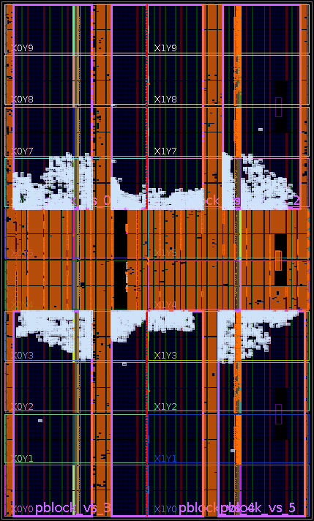
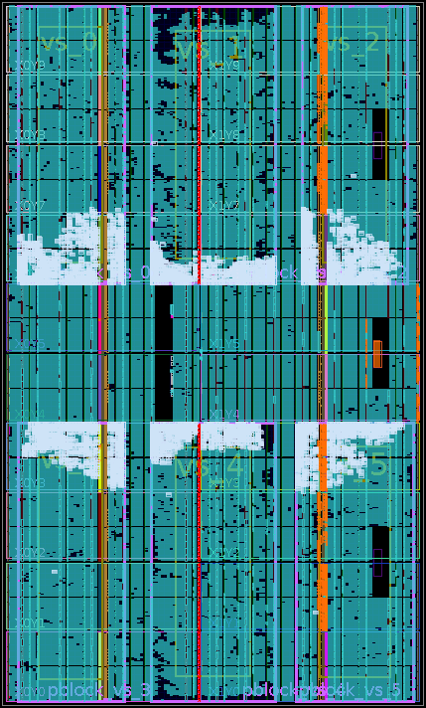
VGG-16 Case Study (2)
VGG-16 Implementation Result on Xilinx VC709
6 PRBs
Group3 Layout
Static Logic
Resource | LUTs | Registers | BRAMs | DSPs
Static | 89786 (21%) | 88305 (10%) | 299 (20%) | 36 (1%)
Group0 | 297507 (69%) | 144697 (17%) | 1283 (87%) | 1764 (49%)
Group1 | 295269 (69%) | 144391 (17%) | 1283 (87%) | 1764 (49%)
Group2 | 300680 (70%) | 150222 (17%) | 1271 (86%) | 1764 (49%)

Slide 17
VGG-16 Case Study (3)
Comparison with Previous Works
 | FCCM 2017 | FPGA 2017 | FPGA 2016 | ISLPED 2016 | This Work
Platform | Xilinx ZCU102 | Arria-10 GX 1150 | Altera Stratix-V GSD8 | Xilinx VC709 | Xilinx VC709
DSPs | 2520 | 1518 | 1963* | 3600* | 1764
Freq (MHz) | 200 | 150 | 120 | 150 | 100
Precision | 16b fixed | 8-16b fixed | 8-16b fixed | 16b fixed | 16b fixed
Throughput (GOP/s) | 2940.7 | 645.25 | 117.8 | 290 | 820.8
Latency (ms) | - | 47.97 | 262.9 | 213.6 | 187.0
Power (W) | 23.6 | - | 25.8 | 35 | 27.1
DSPs Efficiency (GOP/s/DSPs) | 1.16 | 0.425 | 0.06 | 0.08 | 0.465
Energy Efficiency (GOP/s/W) | 124.6 | - | 4.57 | 8.29 | 30.29

Slide 18
Outline
Resource-Sharing Pipeline
Hardware Design Architecture
VGG-16 Experiments and Analysis
Conclusion

Slide 19
Conclusion
We propose a new design scheme for dynamic deployment of CNNs on FPGAs:
RS-pipeline: allows for larger algorithms and lower latency compared with conventional pipeline.
Efficient FPGA hardware design: efficient data and control flow, novel memory structure, scalable HLS implementation of Convolutional Layers.
We evaluate the new design scheme with VGG-16 CNN model on Xilinx VC709:
Divide VGG-16 into 18 pipeline stages.
Deploy VGG-16 with a 6-stages RS-Pipeline.
A latency of 187.0ms, a throughput of 820.8GOP/s, better than most of previous works.

Slide 20
Thanks!
Hanchen Ye, Gengsheng Chen
State Key Laboratory of ASIC and System, Fudan University
11/03/2018

Slide 21
Hardware Design Architecture (3)
Convolutional Layer Architecture (HLS)
Double Buffer

Slide 22
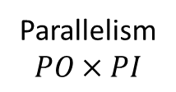
Hardware Design Architecture (3)
Convolutional Layer Architecture (HLS)
Parallelism
$$PO×PI$$

Slide 23
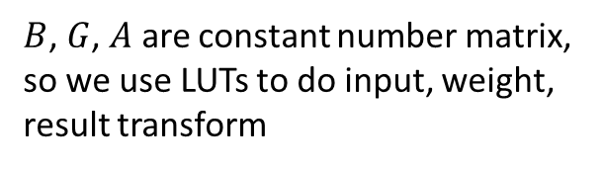
Hardware Design Architecture (3)
Winograd Convolution PE Architecture (HLS)
$B$, $G$, $A$ are constant number matrix, so we use LUTs to do input, weight, result transform

Slide 24
Hardware Design Architecture (3)
Winograd Convolution PE Architecture (HLS)
$B$, $G$, $A$ are constant number matrix, so we use LUTs to do input, weight, result transform
We use DSPs to do EWMM, and DSPs utilization for each PEs is 36

