Slide 1
HybridDNN: A Framework for High-Performance DNN Accelerator Design and Implementation
Hanchen Ye
University of Illinois at Urbana-Champaign

Slide 2
Outline
Background
Motivation
Hardware Architecture
Experimental Results
Conclusion

Slide 3
Background
Design and Optimization of DNN Accelerators on FPGAs

Slide 4
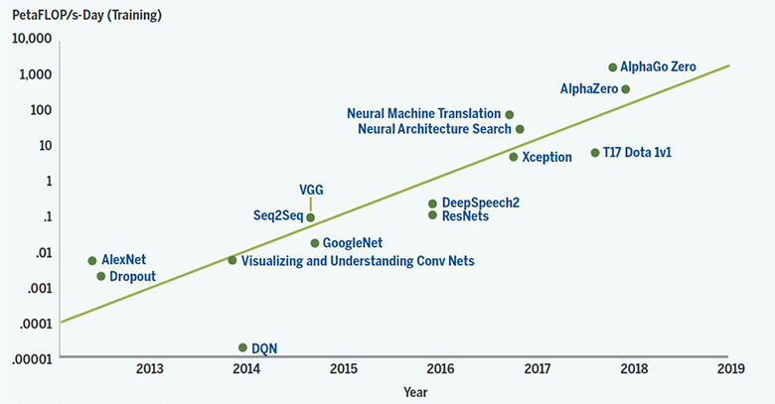
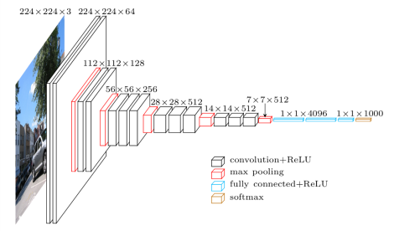
Deep Neural Networks (DNN)
VGG16 (for image classification):
Follow a layer-based structure
General matrix multiplication (GEMM) and convolution (CONV) operations contribute most computations
Rapidly Evolving Exponentially Growing
We desire flexible and dedicated hardware DNN accelerators
Left figure source: K. Simonyan et al. Very Deep Convolutional Networks for Large-Scale Image Recognition, in ICLR 2015.
Right figure source: https://openai.com/blog/ai-and-compute/

Slide 5
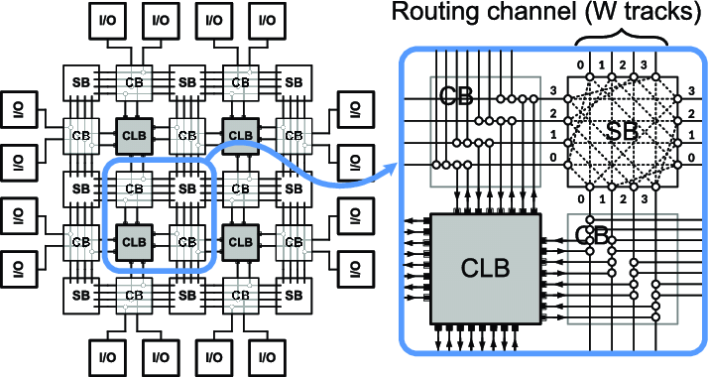




Field Programmable Gate Array (FPGA)
FPGA Resources
CLB: Configurable Logic Block
  Contains LUT, Register, Mux
SB: Switch Block
CB: Connection Block
DSP, BRAM, URAM, etc.
Compared to ASIC
Configurable hardware design => Flexible for various DNN models
Fast time-to-market solution => Follow the rapid evolution of DNN
Compared to GPU
Direct compute on hardware => Low DNN inference latency
Customized hardware design => High energy efficiency (GOPS/W)
FPGA is promising for various scenarios
Top figure source: T. Qin et al. Performance Analysis of Nanoelectromechanical Relay-Based Field-Programmable Gate Arrays, in IEEE Access 2018.

Slide 6
DNN Accelerators on FPGAs: Design
External Memory
External Memory
  For storing input data, intermediate results, and weights
On-chip Buffers
  Implemented with BRAMs or URAMs
Processing Engine (PE)
  An array of MAC units implemented with DSPs
  Carry out the parallel computation of CONV or GEMM
  Same PE reused by all DNN layers
DSPs number determines the maximum parallelism
Weight Buffer
I/O Buffer
Processing
Engine (PE)
Calculation of One DNN Layer
Tile #0
Load Data
Compute
Store Data
Time
Tile #1
Load Data
Compute
Store Data
FPGA
Acc. Buffer
Tile #2
Load Data
Compute
Store Data
… …
… …

Slide 7





DNN Accelerators on FPGAs: Optimization
Rooline model: $Perf_{achievable}=min⁡(CTC×Bandwidth, Perf_{peak})$
$CTC$ denotes computation-to-communication ratio, $Bandwidth$ denotes external memory bandwidth.
$$Perf_{peak}^{′}$$
B’
Data reuse optimization
  $CTC$ ↑
DNN model compression
  Including quantization, pruning, etc.
  $Perf_{peak}$ ↑, $CTC$ ↑
Fast convolution algorithms*
  Including Winograd, FFT, etc.
  Reduce the arithmetic complexity of CONV by 2.25x - 4x (for Winograd)
  $Perf_{peak}$ ↑, $CTC$ ↓
Performance (GOPS)
$$Perf_{peak}$$
B
A’
A
CTC
$$CTC_{A}$$
$$CTC_{A}^{′}$$
Layer A is memory-bounded
Layer B is computation-bounded
* Source: L. Andrew et al. Fast algorithms for convolutional neural networks, in CVPR 2016.

Slide 8
Motivations
Challenges of Winograd-based DNN Accelerators

Slide 9
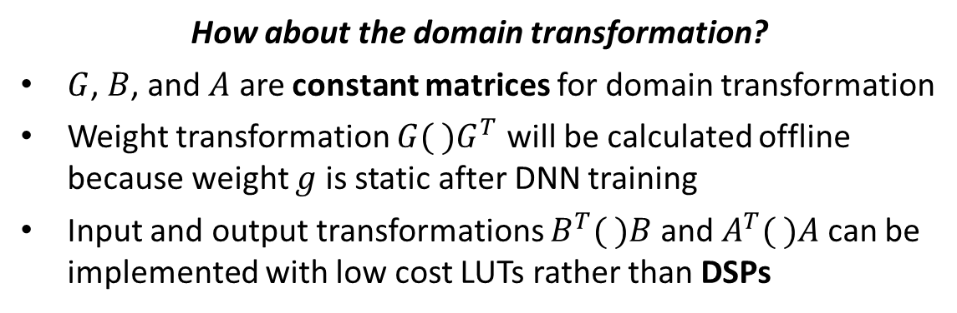
Winograd Fast Convolution Algorithm
CONV in Spatial Domain
EWMM in Winograd Domain
(Element-wise matrix multiplication)
3x3
2.25x lower computation complexity => 2.25x peak performance
  CONV in Spatial domain: 2x2x3x3=36 multiplications
  EWMM in Winograd domain: 4x4=16 multiplications
1.78x larger weight size => 0.56x CTC ratio
  Weight size in Spatial domain: 3x3=9
  Weight size in Winograd domain: 4x4=16
4x4
How about the domain transformation?
$G$, $B$, and $A$ are constant matrices for domain transformation
Weight transformation $G( )G^{T}$ will be calculated offline because weight $g$ is static after DNN training
Input and output transformations $B^{T}( )B$ and $A^{T}( )A$ can be implemented with low cost LUTs rather than DSPs
Will not impact the parallelism of PE

Slide 10




Problems of Winograd-based DNN Accelerators
$$Perf_{peak}^{wino}$$
Weight Buffer
2.25x
I/O Buffer
Processing
Engine (PE)
Homogeneous
Winograd
Processing
Engine (PE)
Performance (GOPS)
0.56x
$$Perf_{peak}^{spat}$$
C ^{spat}
C ^{wino}
FPGA
Acc. Buffer
CTC
$$CTC_{C}^{wino}$$
$$CTC_{C}^{spat}$$
Previous Winograd-based implementation on FPGA only support 3x3 CONV*
Winograd is inefficient in some cases
Problem #1
Problem #2
Low flexibility for various DNN models with 1x1, 5x5, 7x7 CONV layers
Low efficiency when Spatial CONV outperforms Winograd CONV
* Source: L. Liqiang et al. Evaluating fast algorithms for convolutional neural networks on FPGAs, in FCCM 2017.

Slide 11
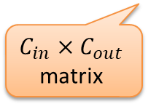
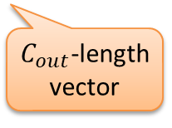

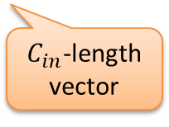
Challenges of Hybrid Architecture
Winograd Tile (4x4)
Both Spatial and Winograd CONV can be represented as GEMM
Different Computation Patterns
How to design the architecture of the reusable PE?
Different Data Patterns
How to switch between Spatial and Winograd CONV?
Design Space Exploration
How to determine which CONV mode to use?
Our Proposal
Weight Buffer
$$C_{in}×C_{out}$$
matrix
$C_{in}$-length
vector
I/O Buffer
Processing
Engine (PE)
Hybrid Spatial and Winograd Processing
Engine (PE)
$C_{in}$, $C_{out}$ denotes input and output channel sizes
GEMM!
$C_{out}$-length
vector
FPGA
Acc. Buffer

Slide 12
Hardware Architecture
A Hybrid Architecture to Improve Flexibility and Efficiency

Slide 13
Functional Modules
LOAD_WGT & LOAD_INP Module
  Load weights and input feature maps from external memory
COMP Module
  Carry out the computation in either Spatial or Winograd CONV mode
SAVE Module
  Write back output feature maps
  Reorder output feature maps to ensure the data pattern in external memory matches the CONV mode of the successive layer
2 modes
SPAT
WINO
2 modes
SPAT
WINO
2 modes
SPAT
WINO
4 modes
SPAT-to-SPAT
SPAT-to-WINO
WINO-to-WINO
WINO-to-SPAT
Module-level Pipeline

Slide 14
CTRL Module
The different data and computation patterns for Spatial and Winograd CONV requires a fine-grained control for the behavior of functional modules.
Customized Instructions Set
CTRL module will load, decode, and dispatch instructions to functional modules

Slide 15
COMP Module Architecture

Slide 16
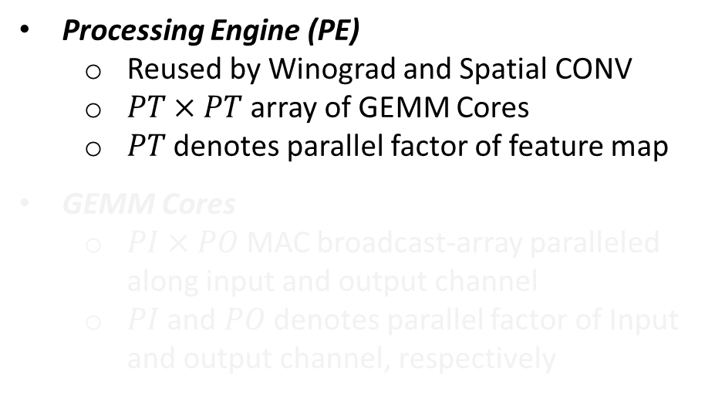
Processing Engine (PE)
Processing Engine (PE)
  Reused by Winograd and Spatial CONV
  $PT×PT$ array of GEMM Cores
  $PT$ denotes parallel factor of feature map
GEMM Cores
  $PI×PO$ MAC broadcast-array paralleled along input and output channel
  $PI$ and $PO$ denotes parallel factor of Input and output channel, respectively

Slide 17
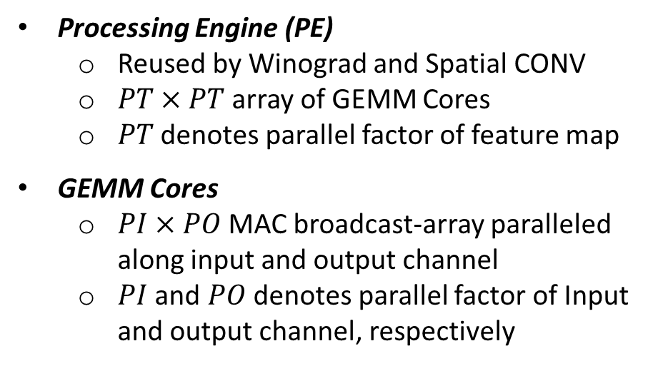
GEMM Cores
PI-length Input Vector
Processing Engine (PE)
  Reused by Winograd and Spatial CONV
  $PT×PT$ array of GEMM Cores
  $PT$ denotes parallel factor of feature map
GEMM Cores
  $PI×PO$ MAC broadcast-array paralleled along input and output channel
  $PI$ and $PO$ denotes parallel factor of Input and output channel, respectively
PO-length Output Vector
How to organize these GEMM cores?

Slide 18
Load and Save Managers
Load & Save Manager
  Can switch the domain PE works in
  On-the-fly domain transformation
PE in Spatial Domain
  All GEMM cores construct a large broadcast array
PE in Winograd Domain
  Each GEMM core works for one element in the feature map tile

Slide 19
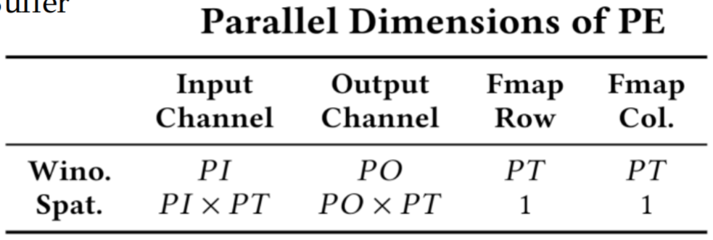
PE in Spatial Domain
Load & Save Manager
  Can switch the domain PE works in
  On-the-fly domain transformation
PE in Spatial Domain
  All GEMM cores construct a large broadcast array
PE in Winograd Domain
  Each GEMM core works for one element in the feature map tile

Slide 20
PE in Winograd Domain
Spatial-to-Winograd
Transformation
Load & Save Manager
  Can switch the domain PE works in
  On-the-fly domain transformation
PE in Spatial Domain
  All GEMM cores construct a large broadcast array
PE in Winograd Domain
  Each GEMM core works for one element in the feature map tile
Winograd-to-Spatial
Transformation
Configurable Tiling Strategy

Slide 21
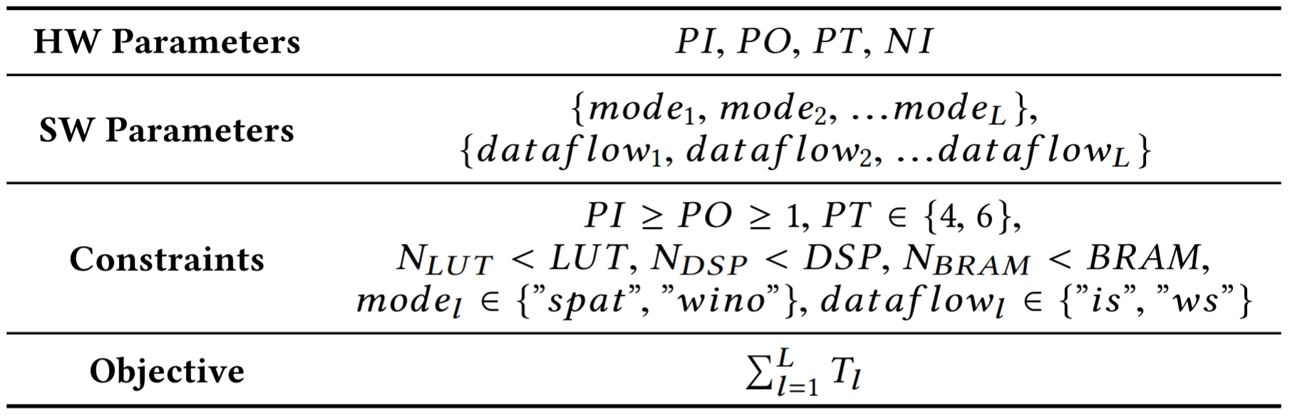
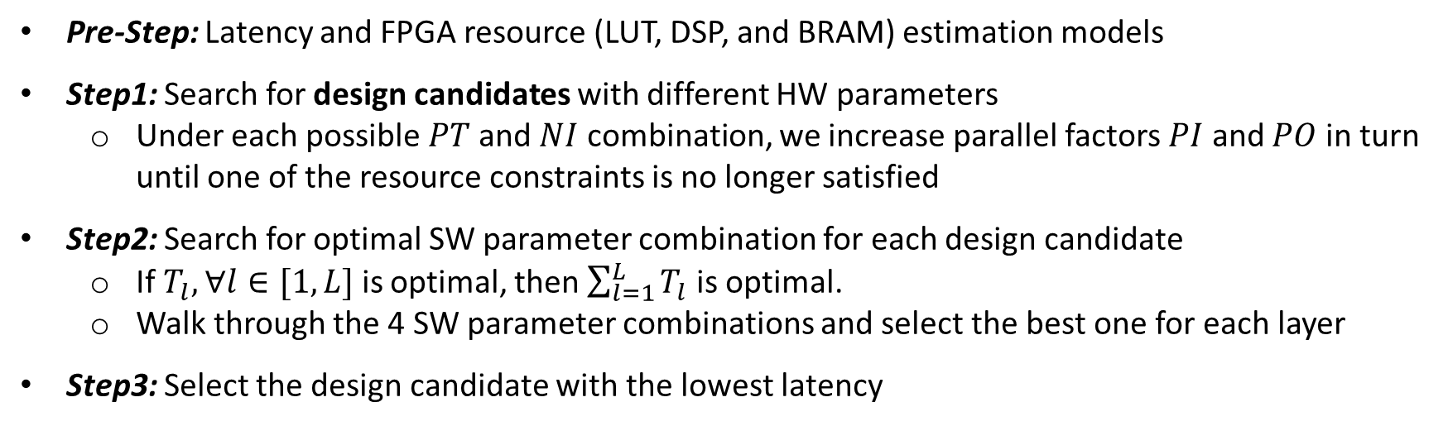
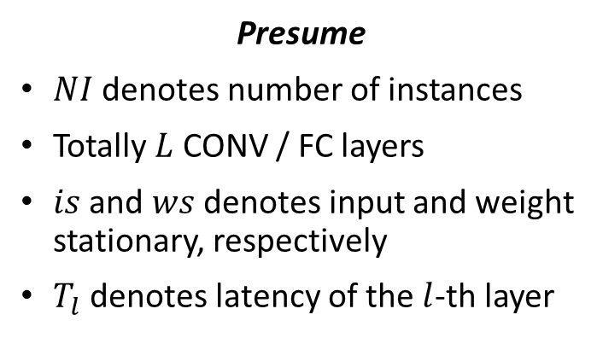

Design Space Exploration (DSE)
Presume
$NI$ denotes number of instances
Totally $L$ CONV / FC layers
$is$ and $ws$ denotes input and weight stationary, respectively
$T_{l}$ denotes latency of the $l$-th layer
$NI∈\left[1,16\right]$,
Pre-Step: Latency and FPGA resource (LUT, DSP, and BRAM) estimation models
Step1: Search for design candidates with different HW parameters
  Under each possible $PT$ and $NI$ combination, we increase parallel factors $PI$ and $PO$ in turn until one of the resource constraints is no longer satisfied
Step2: Search for optimal SW parameter combination for each design candidate
  If $T_{l}, ∀l∈[1,L]$ is optimal, then $\sum_{l=1}^{L}{T_{l}}$ is optimal.
  Walk through the 4 SW parameter combinations and select the best one for each layer
Step3: Select the design candidate with the lowest latency

Slide 22
Experimental Results
Higher Performance and Higher Flexibility

Slide 23
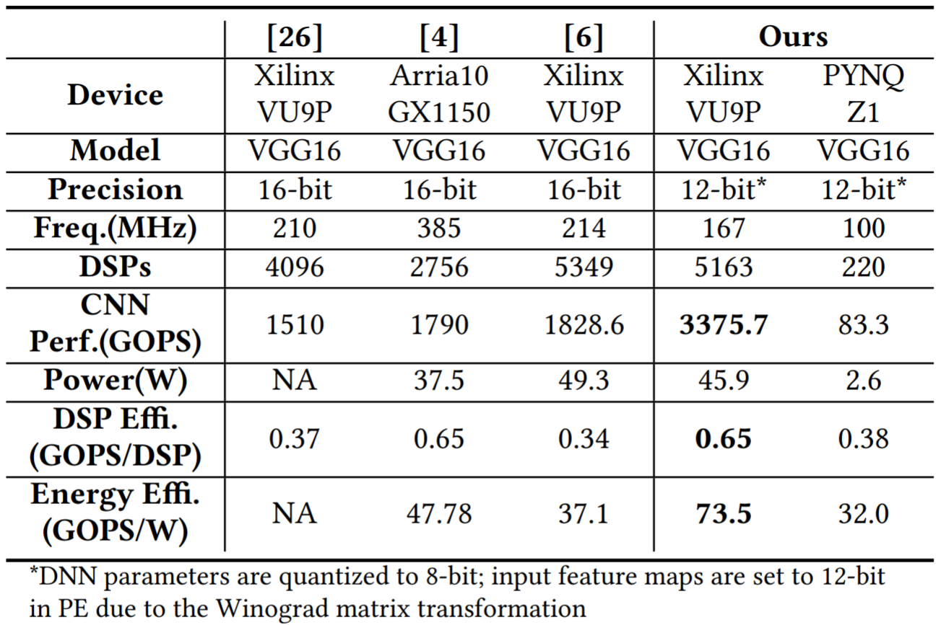
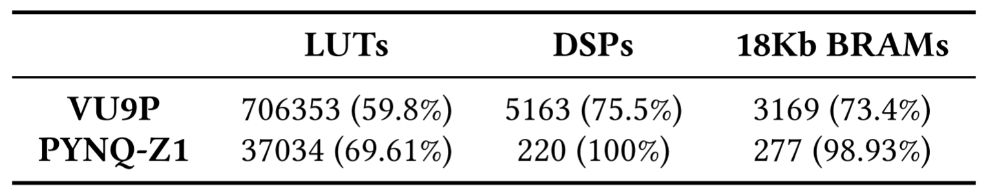
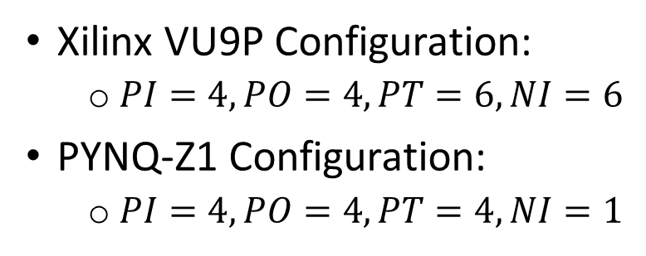
VGG16 Case Study
Xilinx VU9P Configuration:
  $PI=4, PO=4, PT=6, NI=6$
PYNQ-Z1 Configuration:
  $PI=4, PO=4, PT=4, NI=1$

Slide 24
Performance Analysis
CONV Layer Test Cases
  Kernel Size: 1x1, 3x3, 5x5, 7x7
  Feature Size: 224, 112, 56, 28, 14 (yellow areas)
  Channel Size: 512, 256, 128, 64 (grey bars)
Spatial CONV (light blue curve)
  Support all kernel sizes
  Stable and close to peak performance
Winograd CONV (dark blur curve)
  Higher peak performance than Spatial CONV
  Performance is sensitive to feature map size
  Small feature map size => Low CTC ratio => Memory-bounded

Slide 25
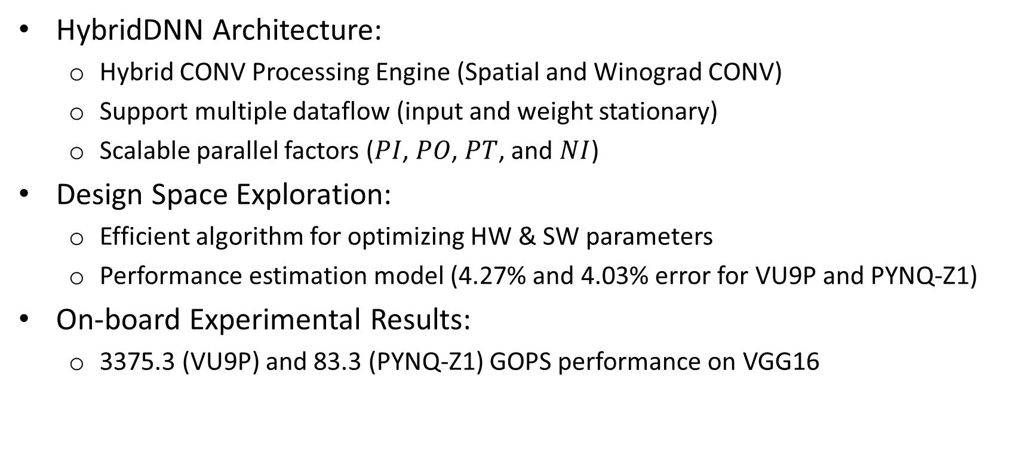
Conclusion
HybridDNN Architecture:
  Hybrid CONV Processing Engine (Spatial and Winograd CONV)
  Support multiple dataflow (input and weight stationary)
  Scalable parallel factors ($PI$, $PO$, $PT$, and $NI$)
Design Space Exploration:
  Efficient algorithm for optimizing HW & SW parameters
  Performance estimation model (4.27% and 4.03% error for VU9P and PYNQ-Z1)
On-board Experimental Results:
  3375.3 (VU9P) and 83.3 (PYNQ-Z1) GOPS performance on VGG16

Slide 26
Thanks!
Hanchen Ye
University of Illinois at Urbana-Champaign

Slide 27
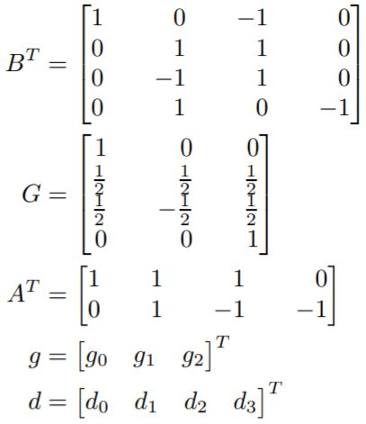
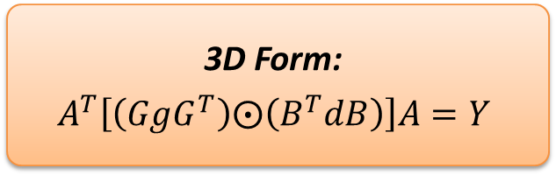
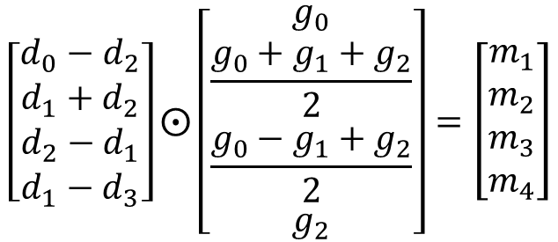
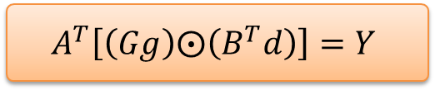



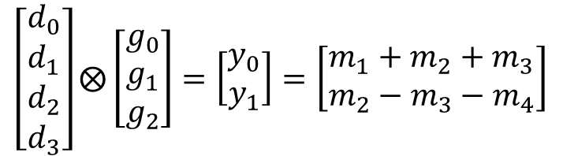
Winograd Fast Convolution Algorithm
Input Tile $d$
Weight $g$
Output Tile $Y$
$$\left[\begin{matrix}d_{0} \\ d_{1} \\ d_{2} \\ d_{3}\end{matrix}\right]⨂\left[\begin{matrix}g_{0} \\ g_{1} \\ g_{2}\end{matrix}\right]=\left[\begin{matrix}y_{0} \\ y_{1}\end{matrix}\right]=\left[\begin{matrix}m_{1}+m_{2}+m_{3} \\ m_{2}−m_{3}−m_{4}\end{matrix}\right]$$
CONV to EWMM
$$\left[\begin{matrix}d_{0}−d_{2} \\ d_{1}+d_{2} \\ d_{2}−d_{1} \\ d_{1}−d_{3}\end{matrix}\right]⨀\left[\begin{matrix}g_{0} \\ \frac{{g_{0}+g_{1}+g}_{2}}{2} \\ \frac{{g_{0}−g_{1}+g}_{2}}{2} \\ g_{2}\end{matrix}\right]=\left[\begin{matrix}m_{1} \\ m_{2} \\ m_{3} \\ m_{4}\end{matrix}\right]$$
3D Form:
$$A^{T}\left[\left(GgG^{T}\right)⨀\left(B^{T}dB\right)\right]A=Y$$
$$A^{T}\left[\left(Gg\right)⨀\left(B^{T}d\right)\right]=Y$$
* Source: L. Andrew et al. Fast algorithms for convolutional neural networks, in CVPR 2016.

Slide 28
Support both Spatial and Winograd CONV?
Run #1
Run #2
Weight Buffer
Weight Buffer
I/O Buffer
Spatial PE
Winog-rad PE
I/O Buffer
Partial Reconfigurable Block
Winograd
Processing
Engine (PE)
Spatial
Processing
Engine (PE)
FPGA
Acc. Buffer
FPGA
Acc. Buffer
Will cause severe resource waste and low efficiency
Typically, PE will utilize most on-chip area, which will cause long reconfiguration latency (ms level)

Slide 29
DNN Accelerators on FPGAs: Design
External Memory
External Memory
  For storing input data, intermediate results, and weights
On-chip Buffers
  Implemented with BRAM or URAM
Processing Engine (PE)
  An array of MAC units implemented with DSP
  Carry out the parallel computation of CONV or GEMM
  Same PE reused by all DNN layers
Weight Buffer
I/O Buffer
Processing
Engine (PE)
Calculation of One DNN Layer
Tile #0
Load Data
Compute
Store Data
Time
Tile #1
Load Data
Compute
Store Data
FPGA
Acc. Buffer
Tile #2
Load Data
Compute
Store Data
… …
Memory-bounded

